Slide 1
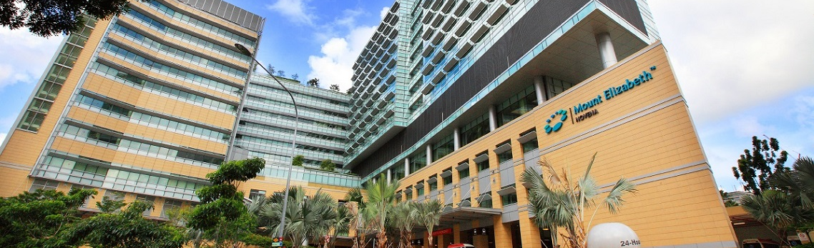

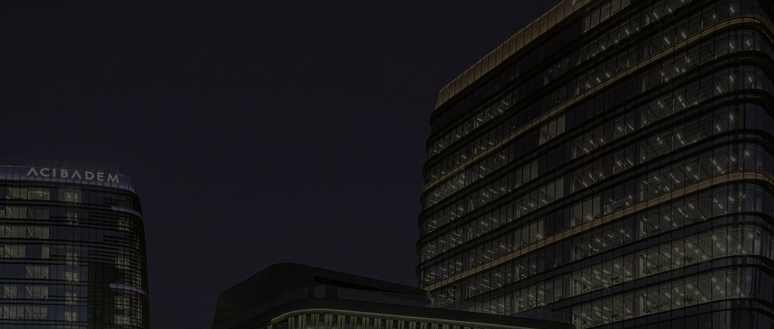
Recommendation: BUY
TARGET PRICE:
SGD 2.40 (+32%)
CURRENT PRICE:
SGD 1.83
IHH HEALTHCARE BERHAD
SGX: Q0F

Slide 2



3 key growth drivers
ACQUISITIONS IN UNDERSERVED MARKETS, INCREASING PROFITS
FIRST ADOPTER OF ADVANCED TREATMENTS, MAKING IHH A PREFERRED PARTNER FOR SPECIALISTS
FOCUS ON SPECIALISED TREATMENT CAPTURES MED TOURISM
2
Notes:
Are we changing to leadership in labor market first then robust growth via acquisitions?

Slide 3
Diversified revenues of RM17.1bn from dominance in 4 key regions
Source: Company Data 2021

Slide 4
IHH one of few players able to treat any complexity of illness
Primary Care
clinics
General
medication
Secondary Care
hospitals
Common
procedures
Tertiary Care
hospitals
Complex
procedures
INTEGRATED SERVICES
Source: Company Data 2021
4

Slide 5

Hub-and-spoke strategy → entrenches patients in ecosystem
Primary
clinics
Primary
clinics
Tertiary
hospital
Secondary
hospitals
Secondary
hospitals
Primary
clinics
Primary
clinics
Primary
clinics
Primary
clinics

Slide 6
1st growth driver: first-mover acquisitions
ACQUISITIONS IN UNDERSERVED MARKETS, INCREASING PROFITS
FIRST ADOPTER OF ADVANCED TREATMENTS, MAKING IHH A PREFERRED PARTNER FOR SPECIALISTS
FOCUS ON SPECIALISED TREATMENT CAPTURES MED TOURISM
Notes:
Now, let us elaborate on the factors we believe will propel the share price upwards.
First, we expect IHH to continue strategic acquisitions in underserved markets that strengthen the group’s ROE.
IHH acquires local hospital and clinic chain operators in new regions with a large customer base who are unable to access high quality specialist treatments (slide 7)
It uses its specialised hospitals in neighbouring regions to capture this underserved market through specialist referrals
This expands IHH’s moat as the largest private healthcare operator with the full range of advanced healthcare services in the combined region (slide 9)
Moving first to provide these new large and growing underserved markets will increase ROA and maximize shareholder returns through ROE

Slide 7

Large underserved market in CEE & India
Lack of specialists
Lack of updated Equipment
New drugs unavailable
Large, underserved customer base
Unable to get high quality advanced treatment

Slide 8
Acquisitions increases revenues per patient
Largest in combined region
Channel underserved patients to specialist hospitals
Increased revenue per patient
Increased profits
Economies of scale
Notes:
Maybe try to use icons instead? Too many words

Slide 9
2nd growth driver: the preferred partner for specialists
ACQUISITIONS IN UNDERSERVED MARKETS, INCREASING PROFITS
FIRST ADOPTER OF ADVANCED TREATMENT, MAKING IHH A PREFERRED PARTNER FOR SPECIALISTS
FOCUS ON SPECIALISED TREATMENT CAPTURES MED TOURISM
Notes:
Secondly, IHH’s leadership in the labour market and equipment allows it to increase its pricing power, fuelling growth in revenue and profits
It is the first mover in key operating regions like SEA and Turkey to purchase the newest, expensive medical devices (slide 11)
It also dominates the specialist market in these regions by attracting highly specialised doctors with these new equipment as well as its operating model, allows doctors to run their own practice and revenue share with the group
Better treatment outcomes from highly incentivised doctors operating the best medical equipment differentiates its services from peers, allowing it to set higher prices, generating increased profits to obtain even better equipment and specialists, deepening their competitive advantage through this positive feedback loop.

Slide 10
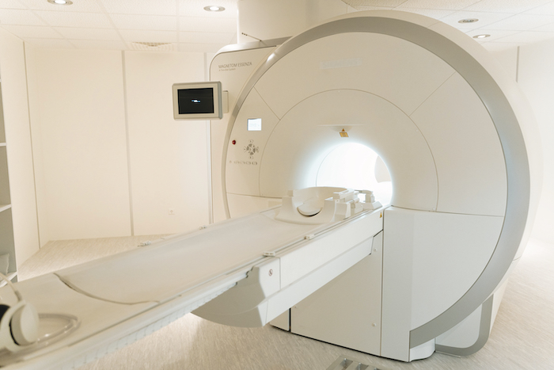
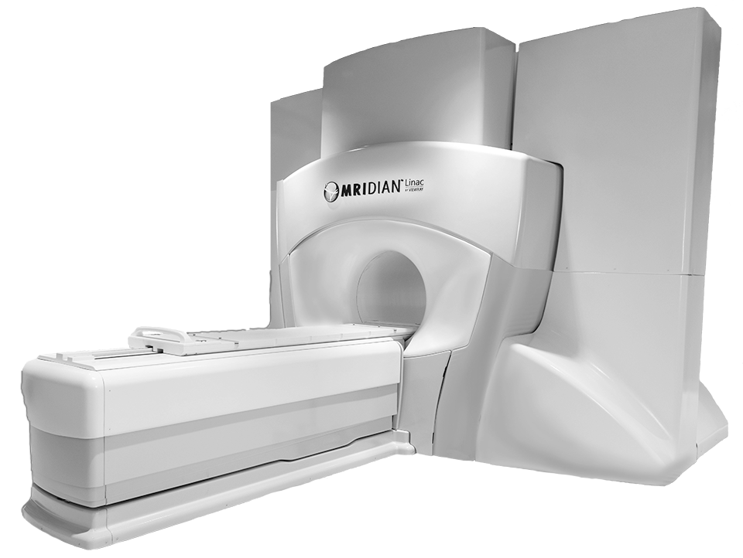
IHH the only provider of newest medical equipment & facilities
Proton Beam | 1st in Southeast Asia | Specialists wanting newest tech must partner with IHH
MRIdian | 1st in Turkey

Slide 11
IHH is the preferred partner for specialists
Revenue sharing model
Attracts and incentivizes top medical talent
Newest equipment
First adopter of advanced treatments

Slide 12
Best equipment and doctors increase pricing power
Sustainable higher prices
.
Strengthens Competitive Advantage
New equipment &
Incentivized specialists
Increased profits

Slide 13
3rd growth driver: capturing med tourism
ACQUISITIONS IN UNDERSERVED MARKETS, INCREASING PROFITS
FIRST ADOPTER OF ADVANCED TREATMENTS, MAKING IHH A PREFERRED PARTNER FOR SPECIALISTS
FOCUS ON SPECIALISED TREATMENT CAPTURES MED TOURISM
Notes:
Finally, IHH’s specialised focus allows it to capitalize on growing demand.

Slide 14

Projected increase in medical tourism expenditure into India + Malaysia
RM 169.9
Billion
RM 41.3
Billion
(2021)
(2027F)
Source: ResearchAndMarkets.com

Slide 15
Expected to have a large impact on IHH’s EBITDA
India + Malaysia is
>1/3
of IHH’s EBITDA
Source: Company Data, 2021

Slide 16
Improving revenue growth after COVID disruption
10.1% CAGR
Source: Company Data, Team Forecast

Slide 17
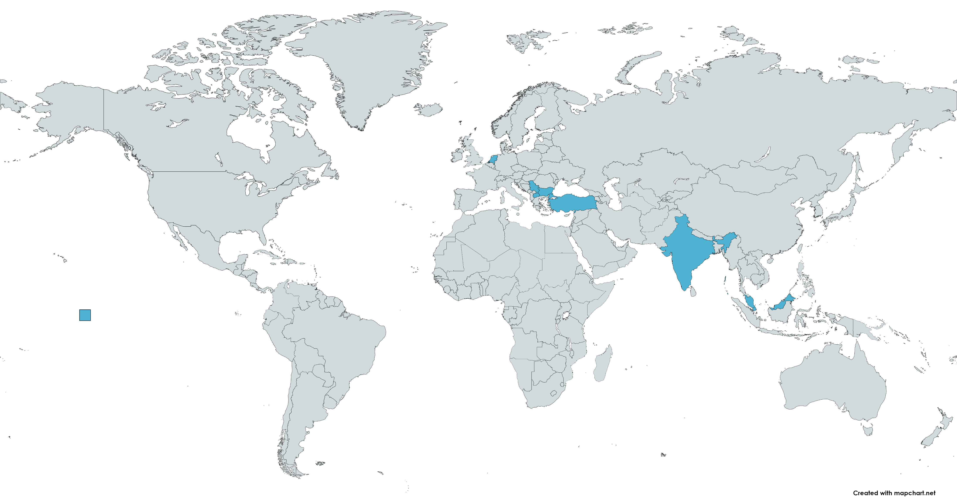
Expansion of hub-and-spoke network driving revenue growth
Central Eastern Europe
Southeast Asia
India
Expansion of its network in operating regions

Slide 18

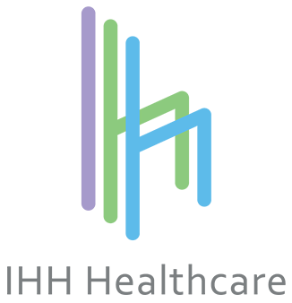

Higher revenue from higher prices
$2,966
$2,248
+31.94%
Colonoscopy
$3,343
+33.18%
Breast Lesion
$2,510
$8,358
$7,844
+6.55%
Hemorrhoids
Source: MOH, 2022

Slide 19
EBITDA growth on the back of strong revenue growth
11.5% CAGR
Source: Team Forecast

Slide 20

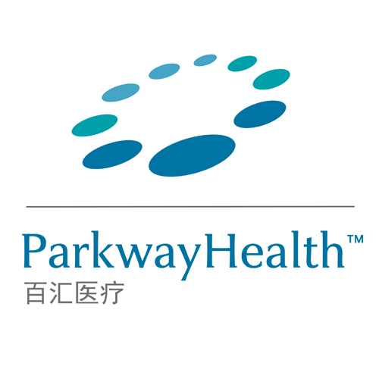



Sale of low EBITDA margin assets and economies of scale to expand group margins
Divestment of underperforming assets
Gleneagles
Chengdu
Parkway
Shanghai
International
Medical
University
EBITDA margins to increase
Cost savings across group post acquisition
COGS
Group procurement initiative
Operational
expenses
Acquisitions of hospital landlords
Source: Team Forecast

Slide 21
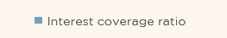
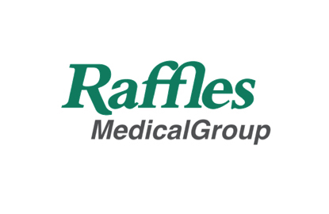



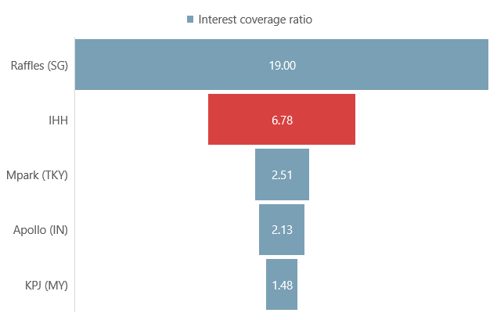
Healthy liquidity amongst its peers
Leveraging on Debt while maintaining healthy interest coverage
Source: Company Data, 2022

Slide 22
DCF analysis shows a positive upside
Cost of Equity
Risk-free Rate
3.1%
Equity Risk Premium
8.0%
9.2%
Cost of Debt
Default spread
0.8%
Tax rate
19%
3.2%
WACC
Market D/E Ratio
18%
8.3%
Terminal growth
Long-run SG inflation
3.0%
3.0%

Slide 23
DCF analysis shows a positive upside
SGD 2.40
Target Price
SGD 1.83
32% UPSIDE
7th February 2023
Terminal growth
2.0% | 2.5% | 3.0% | 3.5% | 4.0%
WACC
7.3%
2.38 | 2.62 | 2.91 | 3.28 | 3.77
2.19 | 2.39 | 2.63 | 2.93 | 3.30
2.04 | 2.20 | 2.40 | 2.64 | 2.94
1.90 | 2.04 | 2.21 | 2.41 | 2.65
1.78 | 1.91 | 2.05 | 2.22 | 2.42
7.8%
8.3%
8.8%
9.3%

Slide 24



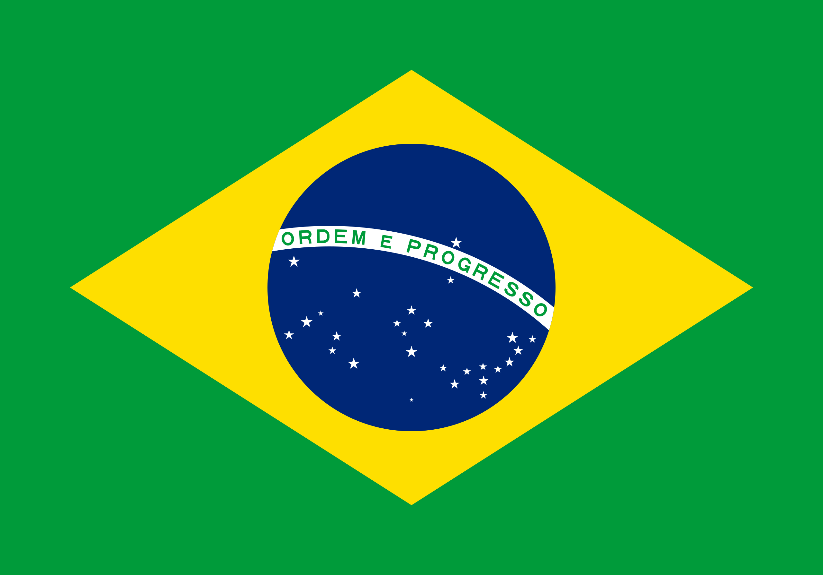









Relative valuation reaffirms our BUY recommendation
MARKET CAP
USD, IN BILLIONS
DOMINANT REGION
FOOTBALL FIELD ANALYSIS
COMPANY
14.42
SGD 2.40
DCF
S$1.78
S$3.77
12.64
Rede D'Or Sao Luiz
12.05
SGD 2.62
P/E
15x
59x
42x
10.72
SGD 2.36
EV/EBITDA
10x
31x
10.44
19x
Universal Health Services
0 1 2 3 4 5
7.63
Share price in SGD
Source: Bloomberg, 2022

Slide 25




Investment risk 1: nursing shortages may lead to increasing staff cost
Mitigant 1:
Reallocation of job roles
Increased nurse attrition rates
Mitigant 2:
Nurse recruitment pipeline

Slide 26






Investment risk 2: IHH is exposed to the depreciation of the Lira
Mitigant 1:
Increasing non-Lira revenue
Depreciation of the Lira
Mitigant 2:
Cross-currency swaps on loans

Slide 27


ESG governance: no one party holds too much power
Top 2 shareholders
Percentage of total shares
32.8%
25.7%

Slide 28

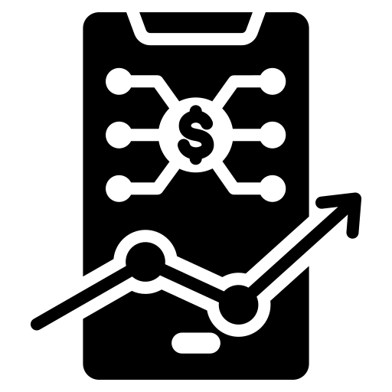
ESG social: greater trust in the company by patients
PATIENT’S TRUST
IN THE COMPANY
Customized price prediction
for each patient
Increase in cost transparency

Slide 29
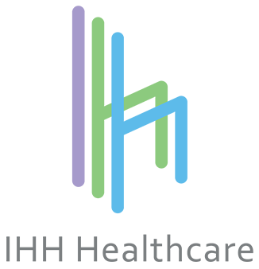







ESG environment: more energy & resource efficient than peers

Slide 30
Reiterating our buy call
ACQUISITIONS IN UNDERSERVED MARKETS, INCREASING PROFITS
IHH
BUY
Target price:
SGD 2.40
FIRST ADOPTER OF ADVANCED TREATMENTS, MAKING IHH A PREFERRED PARTNER FOR SPECIALISTS
SPECIALIZED FOCUS TO CAPITALIZE ON MED TOURISM

Slide 31
EBITDA margin expansion to gradually increase
EBITDA margin

Slide 32
General hospital data
Countries | Number of Hospitals
Malaysia | 16
Singapore | 4
India | 31
Turkey & Europe | 22

Slide 33
Divestment of low EBITDA margin segments to expand group margins
Assets | Revenue(2021) | % of Group Revenue | EBITDA(2021) | % of Group EBITDA
 | RM 165 Million | 0.96% | - RM 46.6 Million | -1.09%
IMU | RM257.6 Million | 1.50% | RM 86.7 Million | 2.03%
Gleneagles
Chengdu
Parkway
Shanghai

Slide 34
Financial Highlights
Financial Year Ended 31 December | 2022 | 2021 | 2020 | 2019 | 2018
Revenue (RM mil) | 13,131.90 | 17,131.80 | 13,404.60 | 14,912.50 | 11,520.90
Earnings Before Interest, Tax, Depreciation & Amortisation (EBITDA) (RM mil) | 2,978.00 | 4,279.40 | 2,876.30 | 3,317.70 | 2,477.70
EBITDA margin (%) | 22.7 | 25 | 21.5 | 22.2 | 21.5
Net Income(RM mil) | 1,357.10 | 1,862.50 | 288.9 | 551.5 | 627.7
Net Income Margin (%) | 10.3 | 10.9 | 2.2 | 3.7 | 5.4
Net Operating Income (excluding exceptional Items)) (RM mil) | 1,040.30 | 1,594.80 | 715.3 | 920.7 | 1,027.60
Net Income Margin (excluding exceptional items)) (%) | 7.9 | 9.3 | 5.3 | 6.2 | 8.9
Total Shareholders' Equity(excluding non-controlling interests) (RM mil) | 26,126.00 | 22,424.90 | 21,739.80 | 22,339.50 | 21,994.00
Net Tangible Assets (excluding non-controlling interests) (RM mil) | 10,038.40 | 8,231.60 | 7,626.30 | 7,683.60 | 7,907.90
Net Borrowings (RM mil) | 7,785.50 | 5,856.00 | 7,441.00 | 4,311.00 | 2,807.30
Net Debt / NTA (times) | 0.78 | 0.71 | 0.98 | 0.56 | 0.35
Net Assets Per Share(RM) | 2.97 | 2.55 | 2.48 | 2.55 | 2.51
Basic Earnings Per Share (excluding exceptional items) *(sen) | 11.23 | 17.15 | 7.13 | 9.49 | 11.36

Slide 35
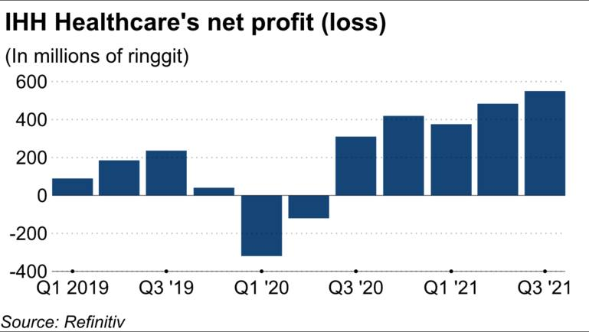

Slide 36
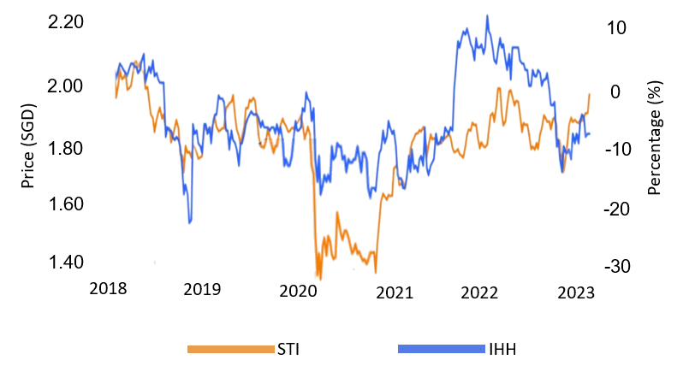
HISTORICAL SHARE PRICE
Source: Refinitiv

Slide 37
Source: ResearchAndMarkets

Slide 39
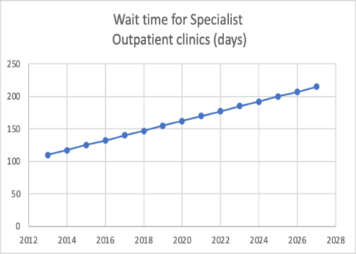
PROJECTED INCREASE IN WAIT TIMES
Specialist Outpatient Clinic Patient wait time (days)
Source: NUS School of Public Health Forecast

Slide 41
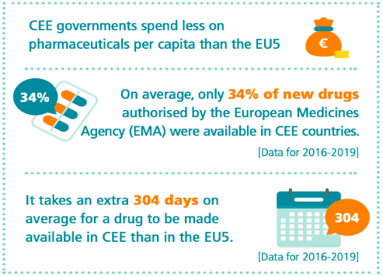
STRUCTURAL DELAY IN PROCUREMENT OF MEDICAL DRUGS WITHIN CEE
Source: EFPIA

Slide 42
Source: Company Data, JP Morgan

Slide 43
IHH DRIVING ROE TO WEIGHTED INDUSTRY AVERAGE
Operating region​ | EBITDA contribution to group​ | Average ROE for hospitals industry​ | Region sampled​
Singapore​ | 40%​ | 15.65%​ | Global​
Malaysia & CEE​ | 46%​ | 10.79%​ | Emerging markets​
India​ | 16%​ | 14.03%​ | India​
Total​ | 102%​ | 13.20% ​ | ​NA
Source: Damodaran
Source: Company Data, Team Consensus

Slide 44
Source: KPJ, IHH & BDMS Company Data

Slide 45
BRAIN DRAIN IN BULGARIA, SERBIA & MACEDONIA
Country | Outflow of medical talent
Bulgaria | Every year Bulgaria loses between 500 and 600 doctors to emigration
Serbia | Country lacks 13000 medical workers in various areas.
Macedonia | Estimated that 1200 doctors left the country between the period from 2010 and 2018 Around 300 medics leave Macedonia every year.
Source: Aljazeera, obserwatorfinansowy, China-IEE institute

Slide 46
RMG TYPICALLY PROVIDES CHEAPER TREATMENT THAN IHH
Treatment Name | Raffles Hospital | Gleneagles Hospital | Mount Elizabeth Novena Hospital | Parkway East Hospital | Mount Elizabeth Hospital
Colonoscopy | $2,248 | $2,725 | $3,038 | $3,377 | $2,725
Nasoendoscopy | $6,932 | $10,265 | $8,651 | $8,849 | $6,926
Breast, Various Lesions (Day Surgery) | $2,510 | $2,710 | $3,849 | Na | $3,469
Intestine/Stomach (Day Surgery) | $3,080 | $3,210 | $3,215 | $3,400 | $2,982
Hemorrrhoids (Day Surgery) | $7,844 | $8,210 | $9,209 | Na | $7,655
Fibreoptic with Removal of Polyp (Day Surgery) | $3,210 | $3,571 | $3,837 | $4,143 | $3,416
Gallbladder surgery (1 bedded ward) | $19,650 | $20,419 | $20,266 | $17,301 | $19,390
Source: Ministry of Health, Singapore

